Slide 1
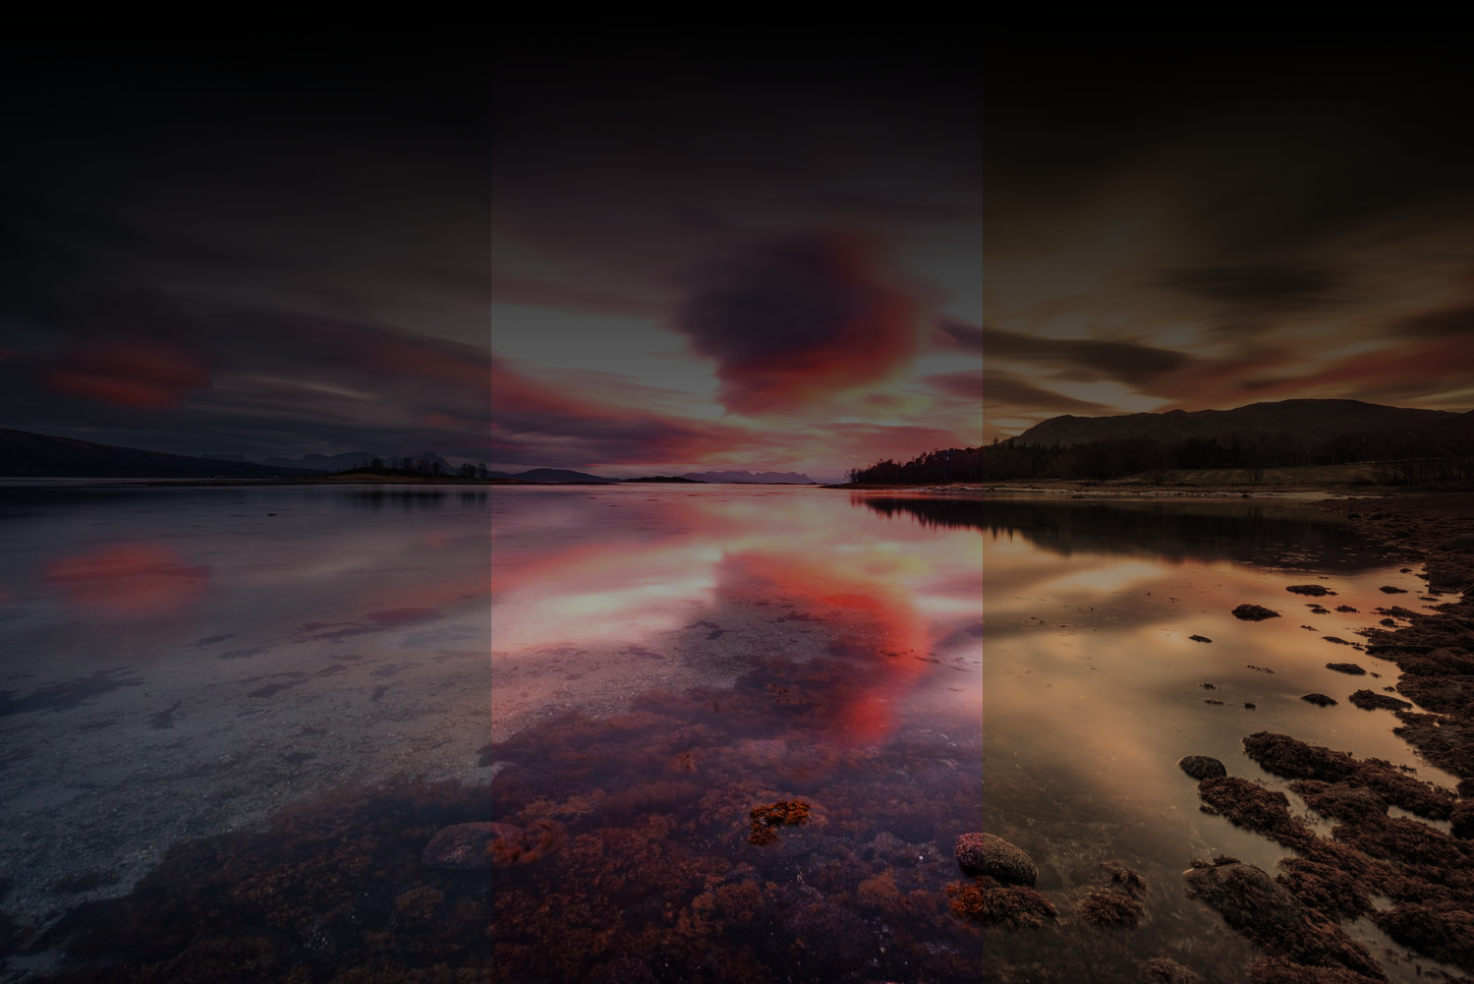
Image Processing Algorithms

Slide 2
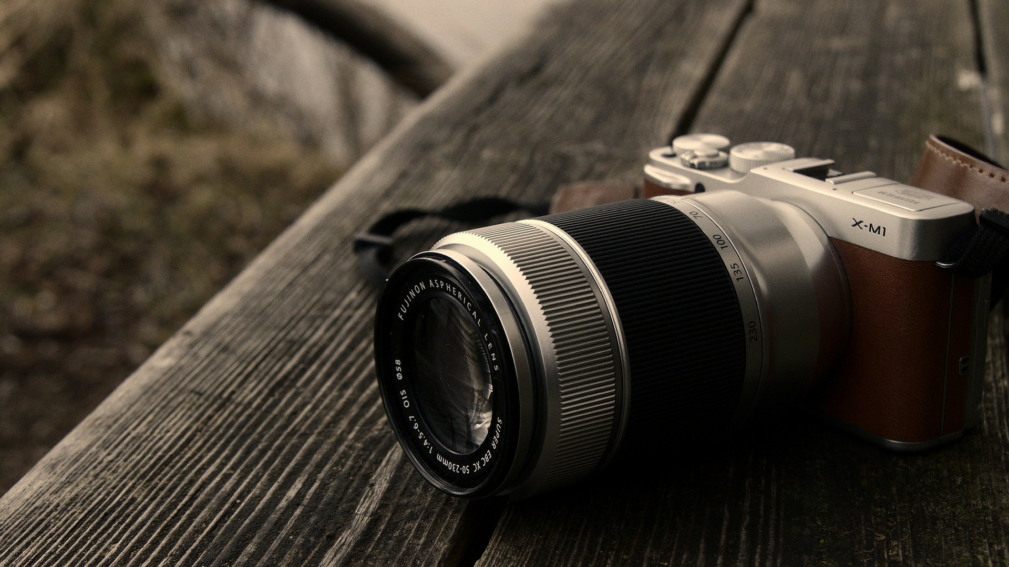
A passion project made by
AbdelRahman Rahal — 221001443
Mahmoud AbdelGelil — 221001313
Mohamed AbdelRaouf — 221001609
Nour Elsharkawy — 221001458

Slide 3
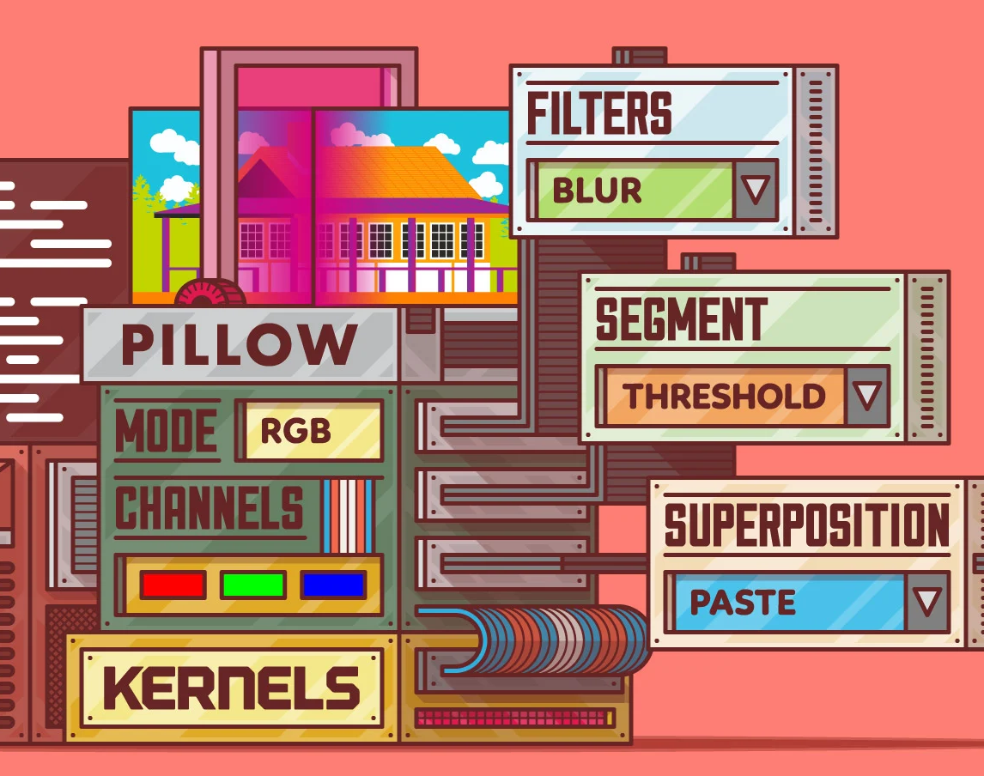
Why image processing?
Medical Field
Gamma-ray imaging
X-Ray Imaging
Medical CT scans
UV imaging
Machine/Robot Vision
Navigation
Obstacle avoidance
Task execution
Photography
Video Processing
Pattern Recognition
Space Exploration
Many many more…

Slide 4
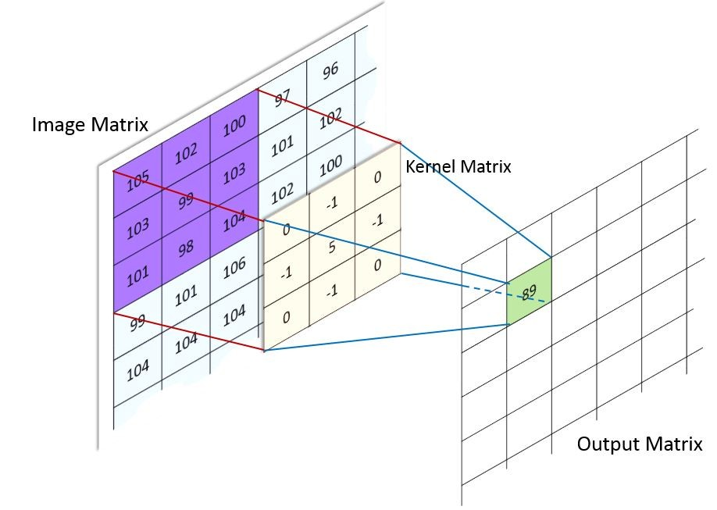
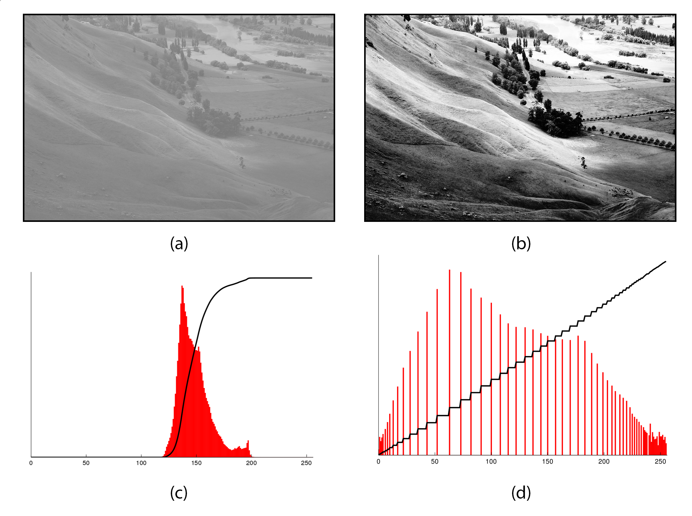
We’ll classify the algorithms we chose into 2 categories
Convolution-Based Algorithms
Non-Convolution-Based Algorithms

Slide 5
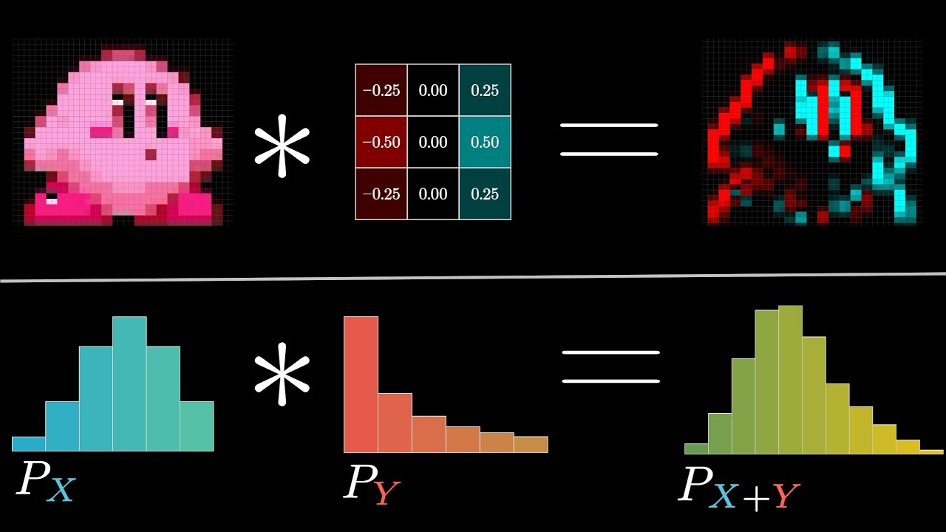
Convolution-Based Algorithms

Slide 6
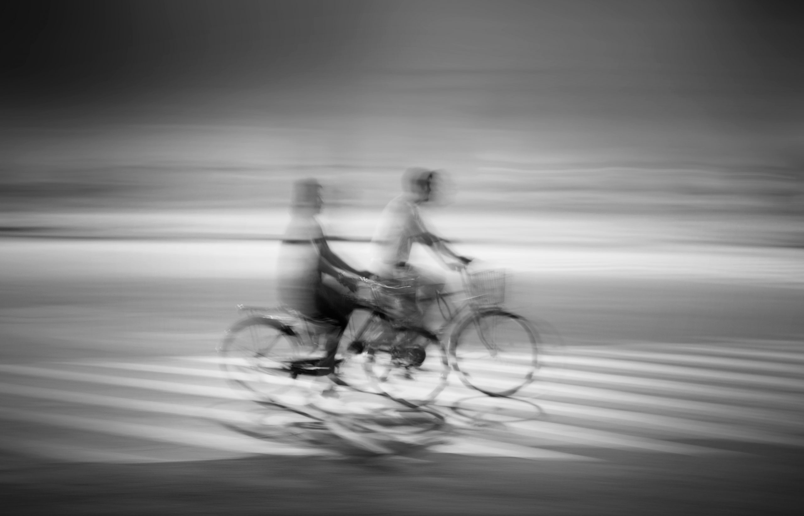
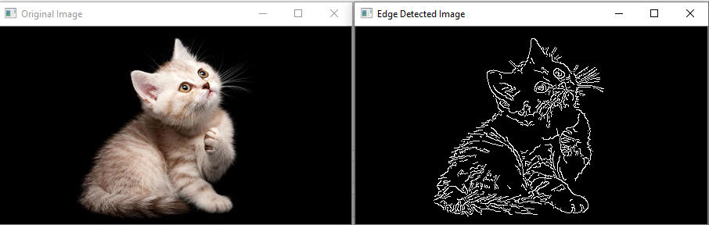
First, what is convolution?
Convolution is a fundamental operation that involves applying a kernel to an image to modify its properties.
This process is crucial for various image processing tasks, including but not limited to blurring, sharpening, edge detection, and noise reduction.

Slide 7
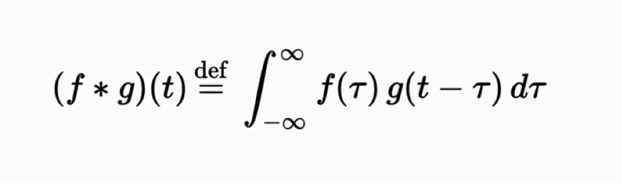
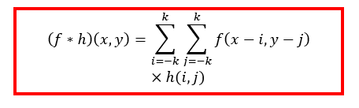
Mathematically, this is how we define convolution:

Slide 8
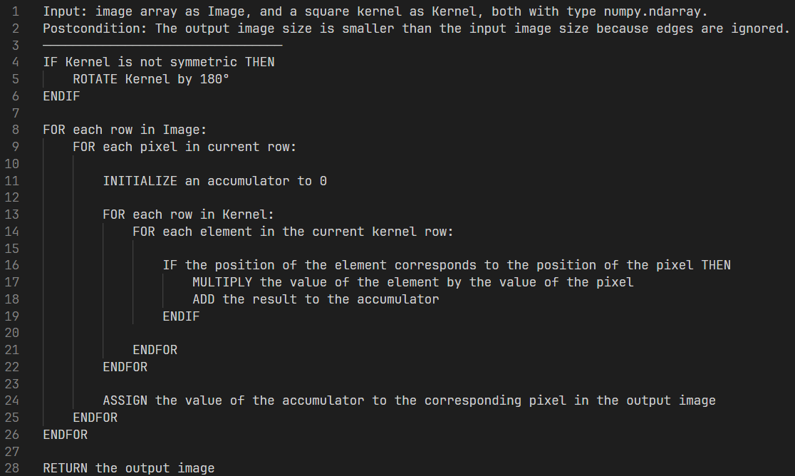
In the context of image processing, this is how we designed our convolution algorithm:

Slide 9
All the pseudocode we wrote for all the algorithms we used, including the one you just saw, are in the source files.

Slide 10


Essentially, for each alignment, the kernel's values are multiplied element-wise with the corresponding pixel values under the kernel, and the results are summed.
This sum becomes the new value for the pixel under the kernel's centre.
This operation is repeated for every pixel in the image, resulting in a new image that reflects the modifications intended by the kernel.

Slide 11
We chose to write 3 convolution-based algorithms
Mean Blur (Noise reduction/blurring)
Gaussian Blur (Image smoothing/blurring)
Sobel Edge Detection (Edge detection)

Slide 12
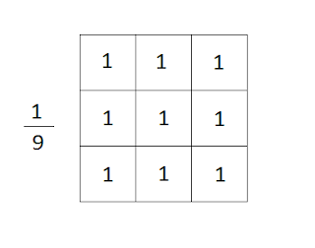
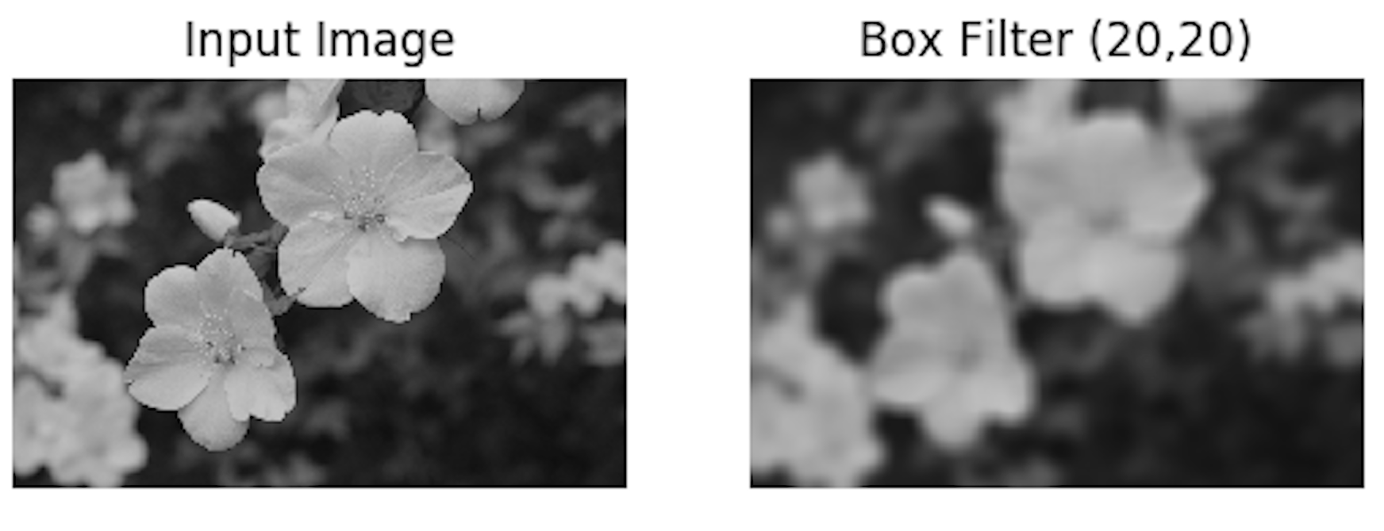
Mean Blur (Also known as Box Blur)

Slide 13
What is Mean Blur?
Mean Blur is a simple image processing technique that reduces image detail and noise by replacing each pixel with the average value of its neighbours, including itself.
It does this by convolving the image with a kernel where all values are equal, typically set to 1, and then dividing by the sum of the kernel values to get the average.
The result is a smoother image where sharp edges and fine details are blurred, making it useful for noise reduction and creating a softening effect.

Slide 14
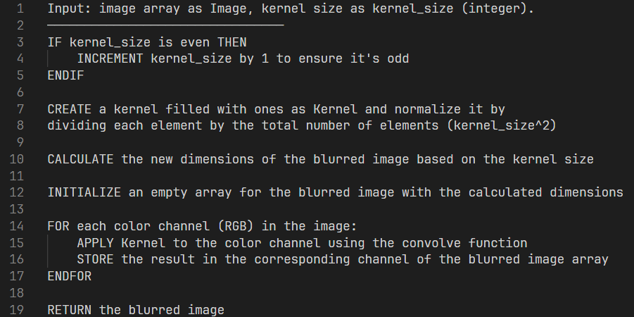
Mean Blur pseudocode:

Slide 15
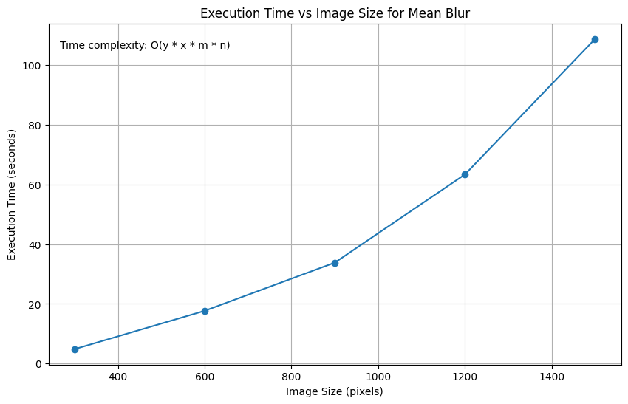
Mean Blur empirical analysis

Slide 16
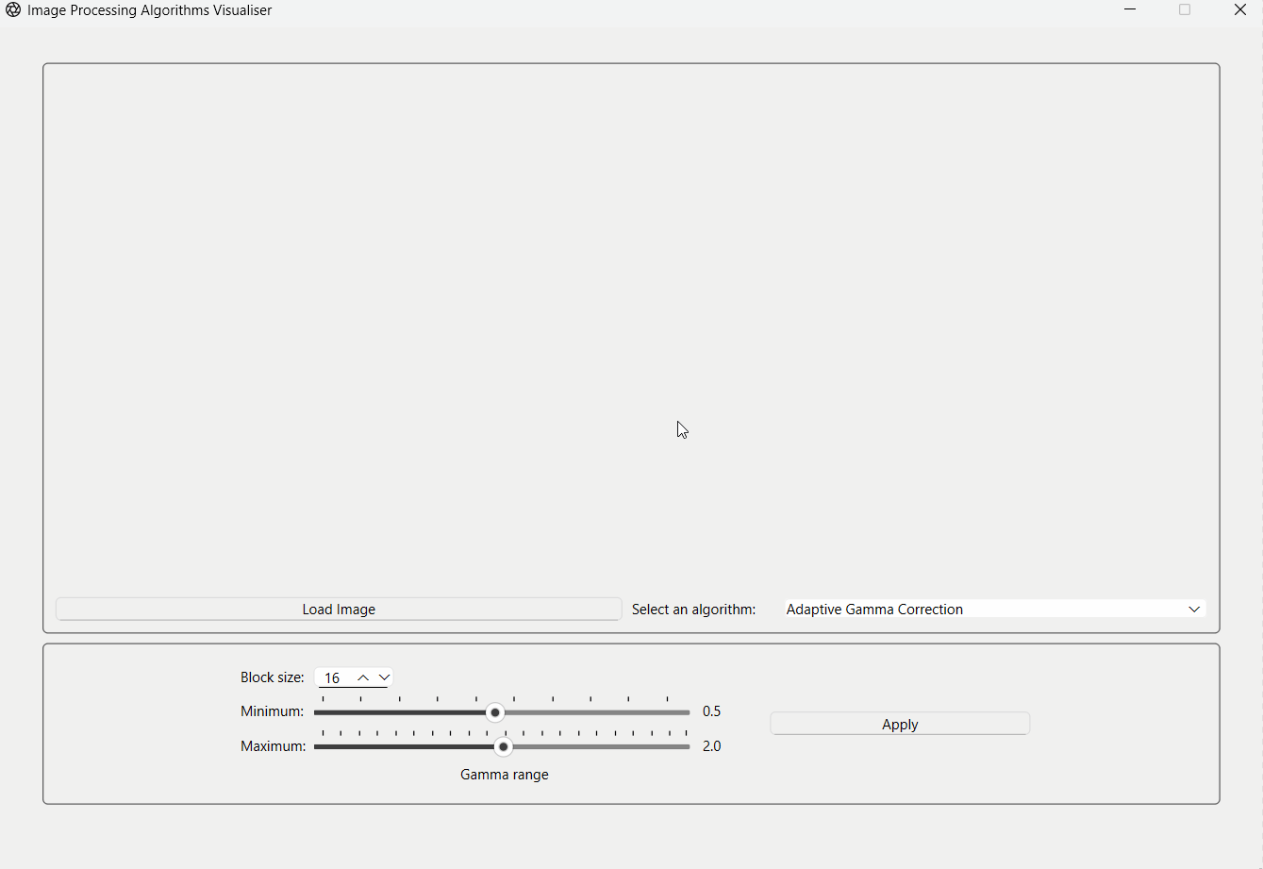
Now, let’s see it in action using our GUI application!

Slide 17
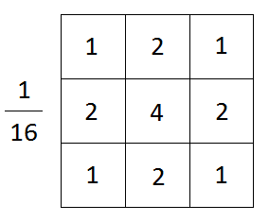
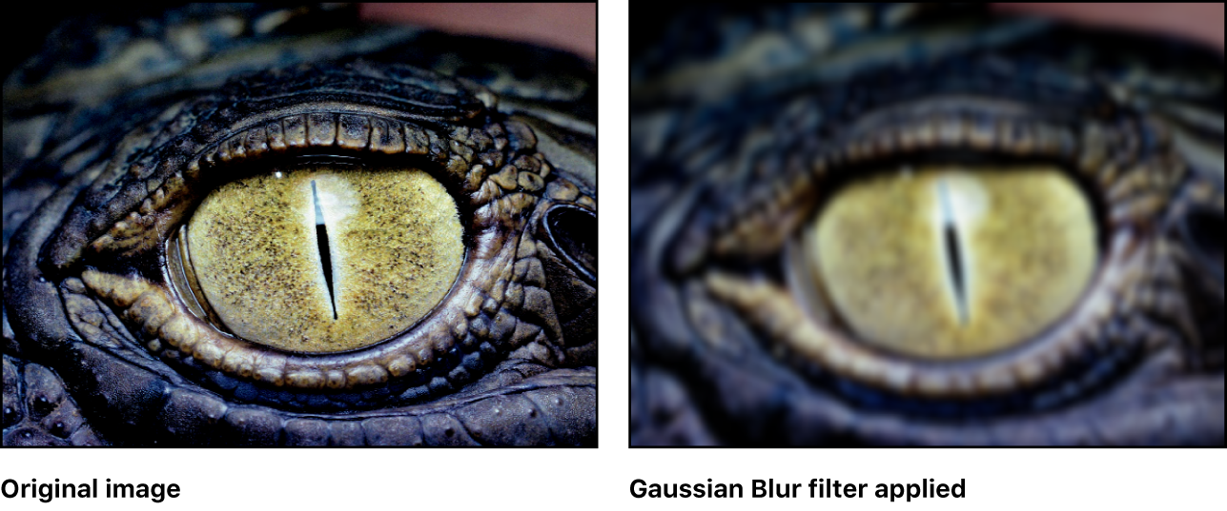
Gaussian Blur

Slide 18
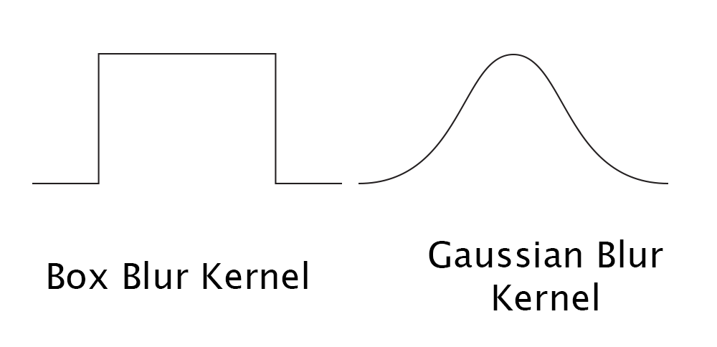
What is Gaussian Blur?
Gaussian Blur is an image processing technique that smooths an image by averaging pixel values with their neighbours, weighted according to a Gaussian distribution.
This method reduces image detail, producing a softer, blurrier image.
Unlike Mean Blur, which uses a uniform weighting for all neighbouring pixels, Gaussian Blur assigns greater weights to closer pixels, resulting in a more natural-looking blur that preserves edges better.

Slide 19
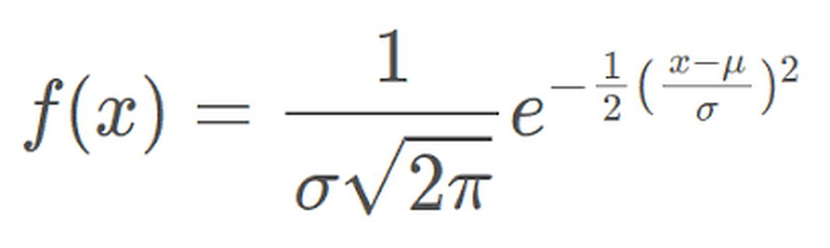
This is the mathematical formula for the Gaussian distribution function:
μ = 0 as there is no meaningful mean value to use
The normalization coefficient is not needed as we normalize the kernel values by dividing by their sum.

Slide 20
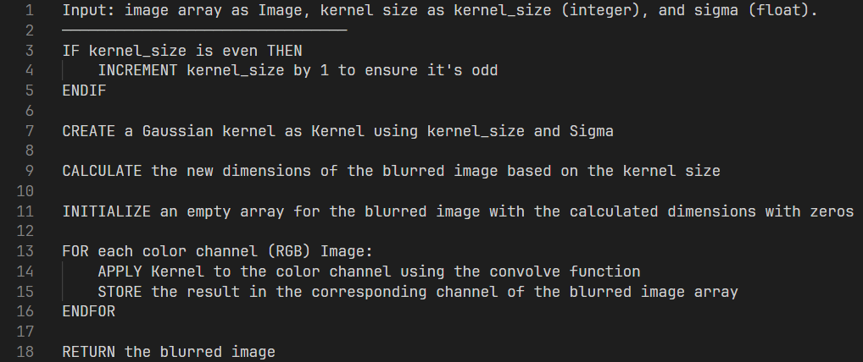
Gaussian Blur pseudocode:
Fun fact: this is what photo editing apps like Photoshop refer to as “radius”. ☺

Slide 21
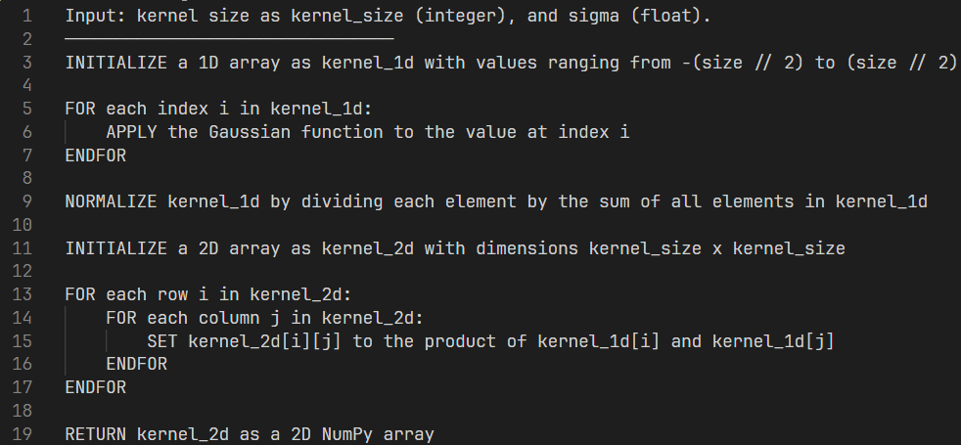
Gaussian Blur helper function (create_gaussian_kernel()) pseudocode:

Slide 22
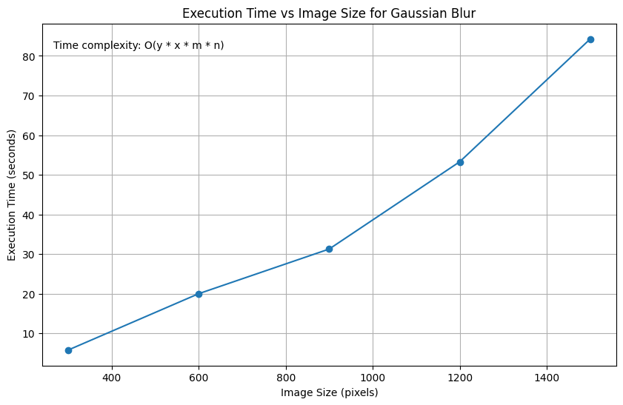
Gaussian Blur empirical analysis

Slide 23
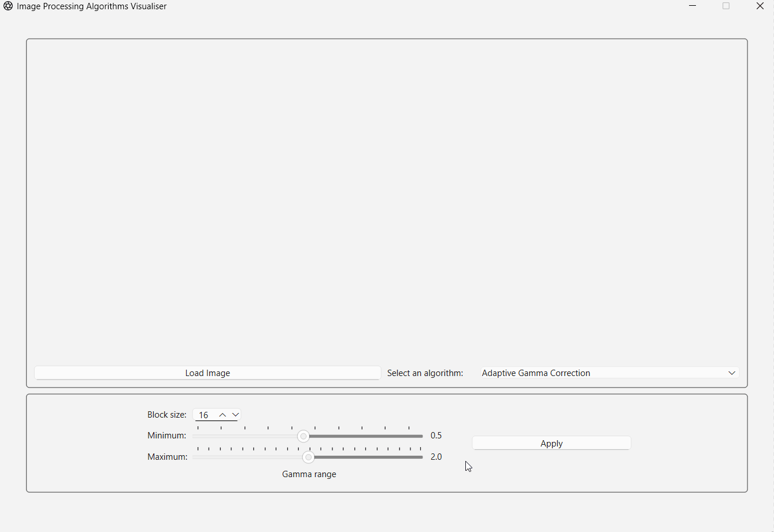
Gaussian blur GUI demonstration:

Slide 24
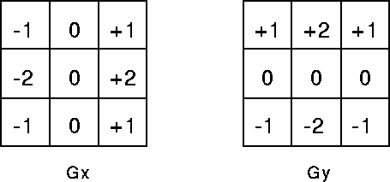
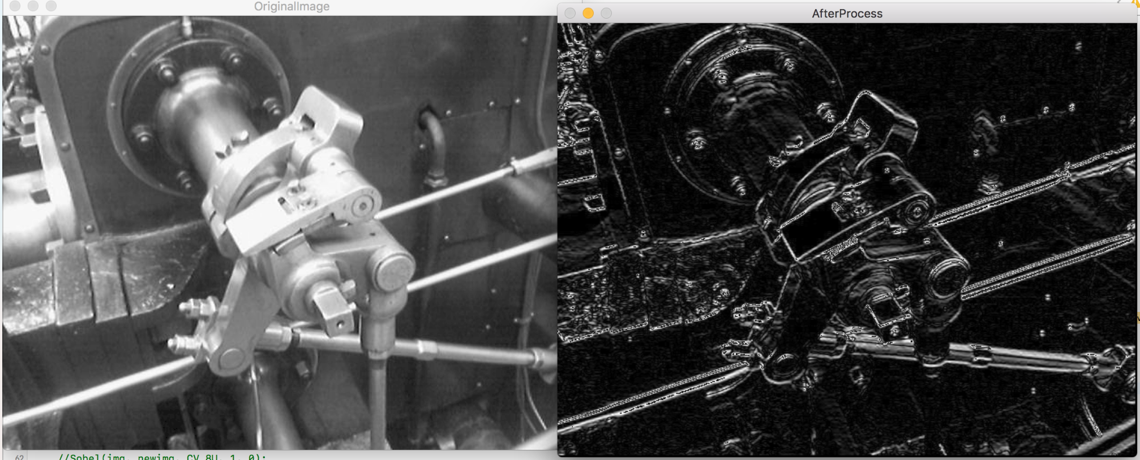
Sobel Edge Detection

Slide 25
First, what is edge detection?
Edge detection is a critical technique in image processing, machine vision, and computer vision, aimed at identifying the boundaries of objects within an image.
These boundaries, referred to as edges, are characterized by sharp changes in image brightness or discontinuities in the image's intensity levels.
Essentially, an edge represents the transition from one region of an image to another, marking the end of one object and the beginning of another.

Slide 26
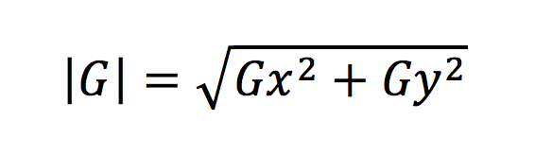
For Sobel Edge Detection, we have 2 operators (kernels)
Sobel has 2 predefined operators (kernels) for each direction, x and y.
The convolution process is applied separately for each direction and the result is then calculated through the magnitude formula:

Slide 27
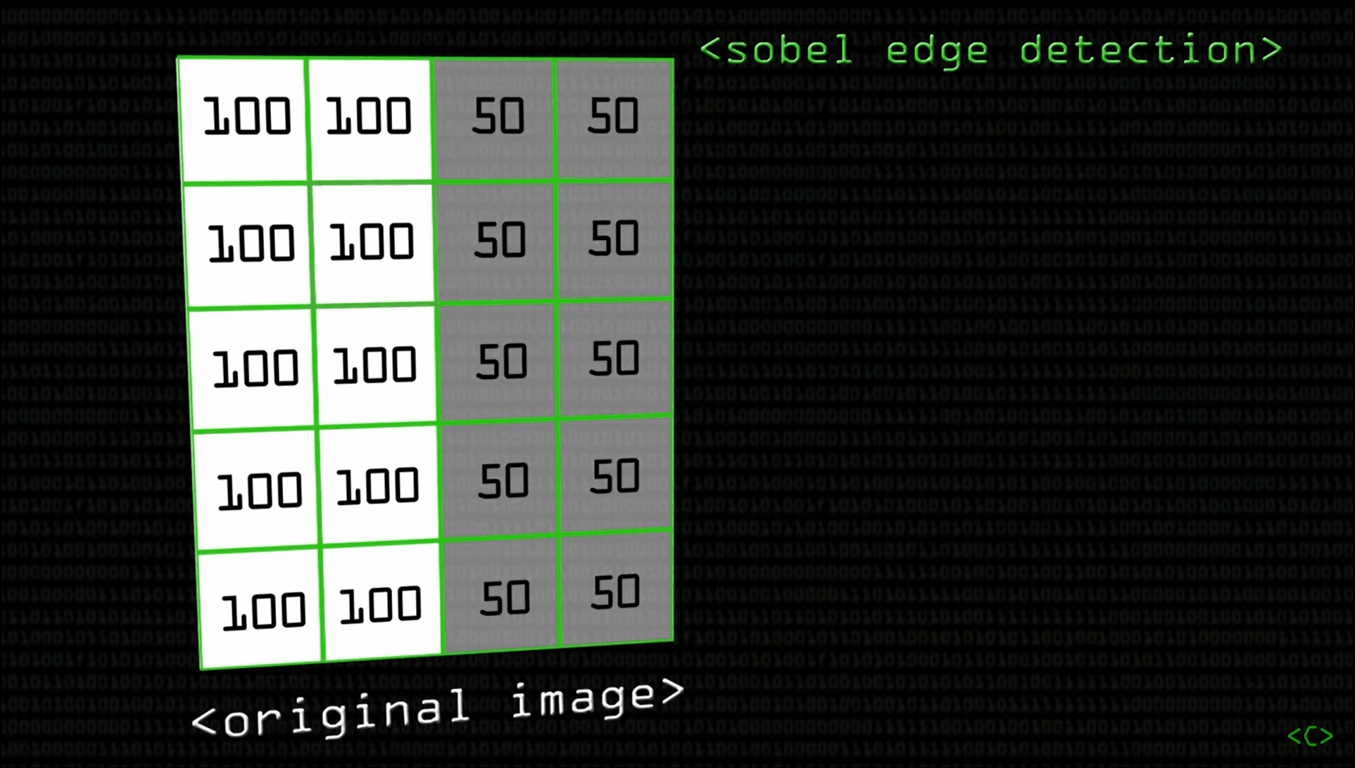
Demonstration:

Slide 28
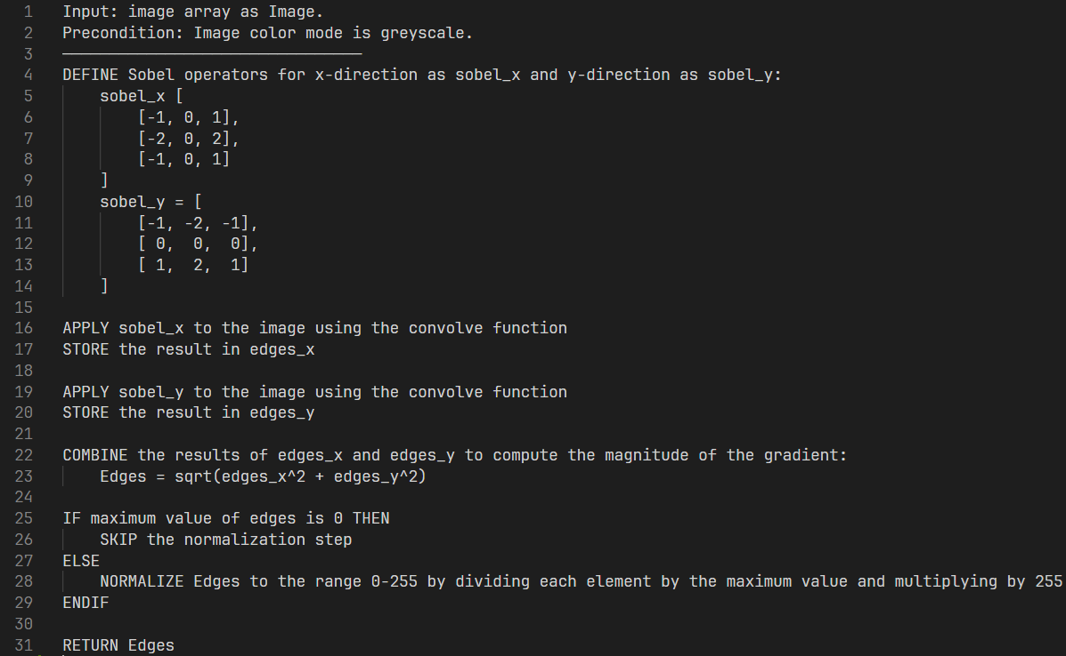
Sobel Edge Detection pseudocode:

Slide 29
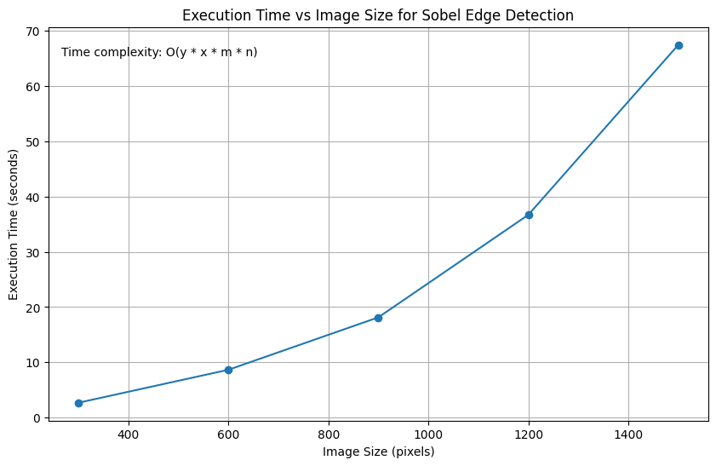
Sobel Edge Detection empirical analysis

Slide 30
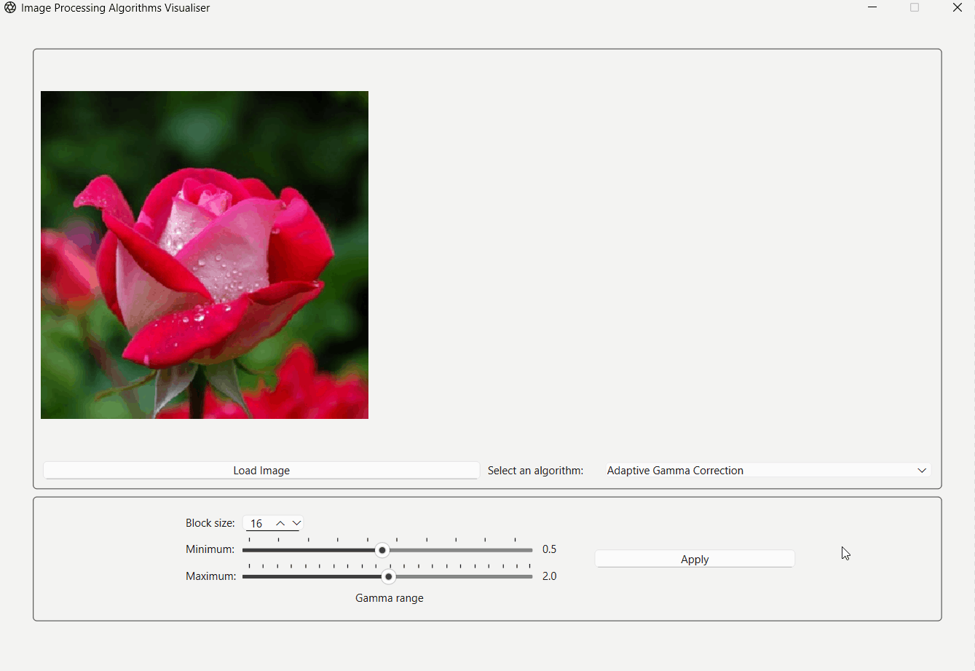
Sobel edge detection GUI demonstration:

Slide 31
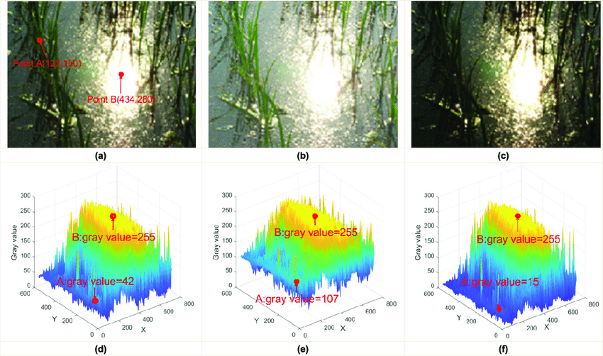
Non-Convolution-Based Algorithms

Slide 32
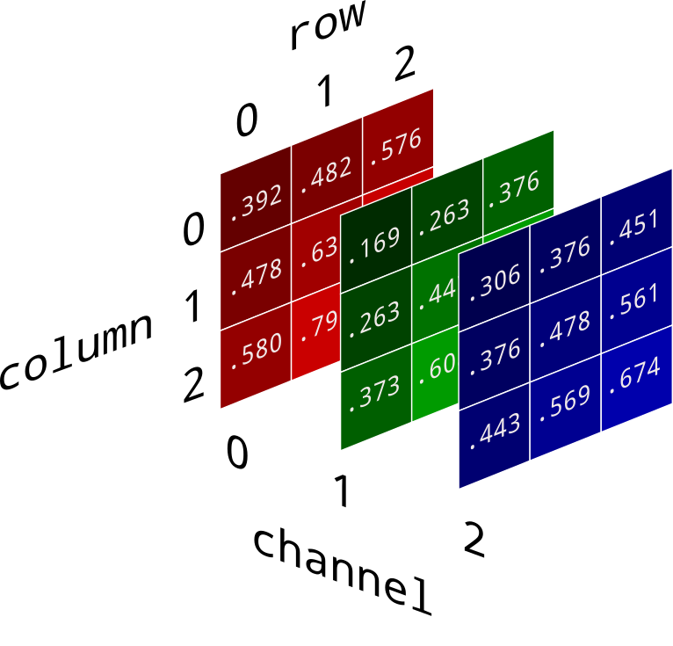
Non-convolution-based algorithms rely on other methods for processing images like using other mathematical transformations, statistical methods, or direct manipulation of pixel values.

Slide 33
We chose to write 3 non-convolution-based algorithms
Histogram Equalization (contrast enhancement)
Gamma Correction (brightness enhancement)
Adaptive Gamma Correction (brightness, contrast, and colour enhancement)
Sepia filter from Instagram/Snapchat (bonus algorithm!)

Slide 34
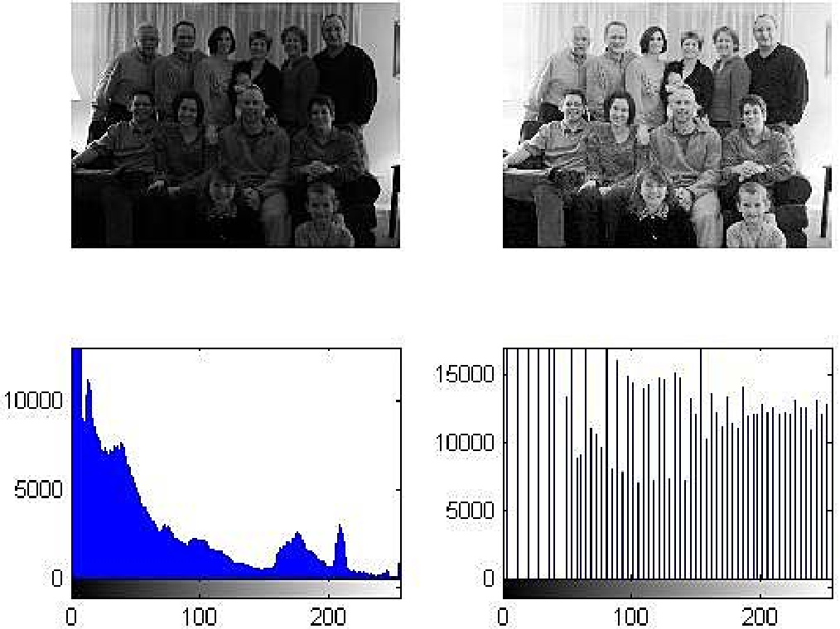
Histogram Equalization

Slide 35
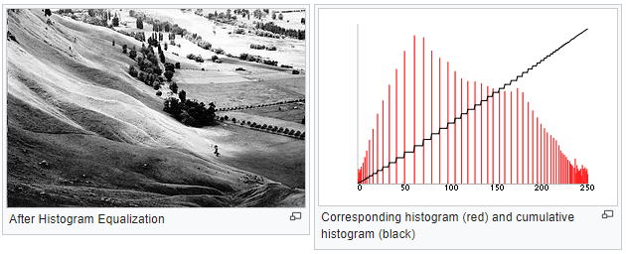
What is Histogram Equalization?
Histogram equalization improves image contrast by adjusting the intensity distribution of the image's histogram.
It aims to stretch out the range of intensity values, making details clearer and enhancing the overall appearance of the image.
This technique is particularly effective for images with low contrast, where it can significantly improve visibility and detail recognition.
Histogram equalization is best used on greyscale images, but it could still be used on coloured ones if coded accordingly.

Slide 36
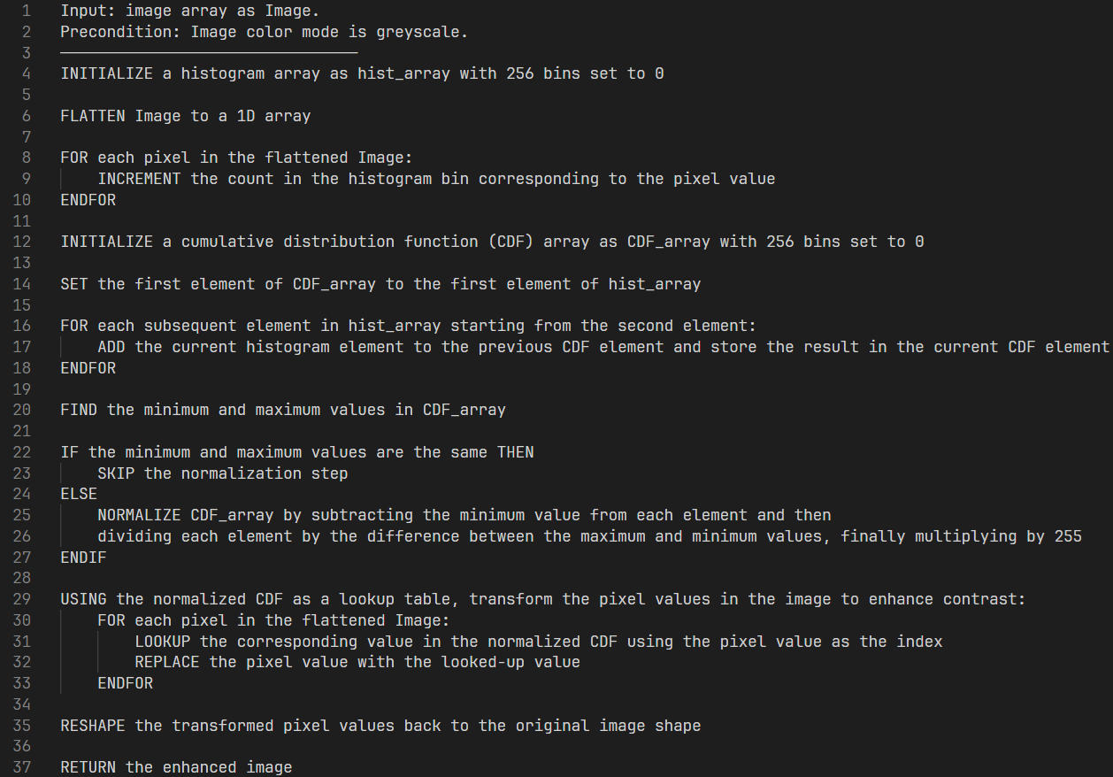
Histogram Equalization pseudocode:

Slide 37
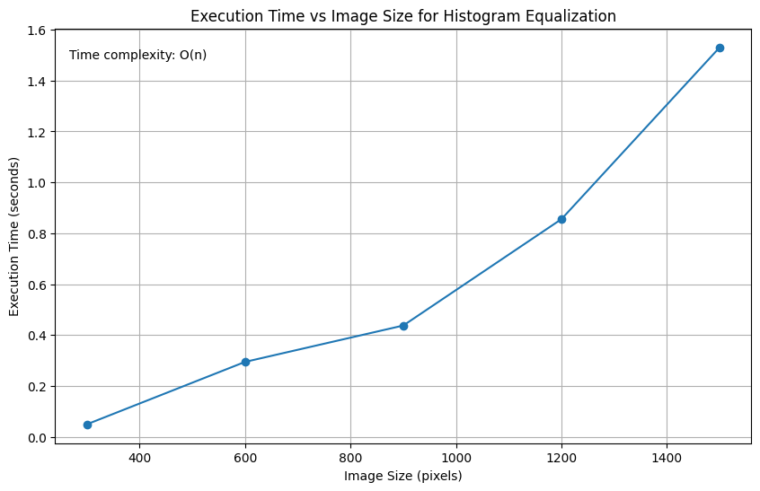
Histogram Equalization empirical analysis

Slide 38
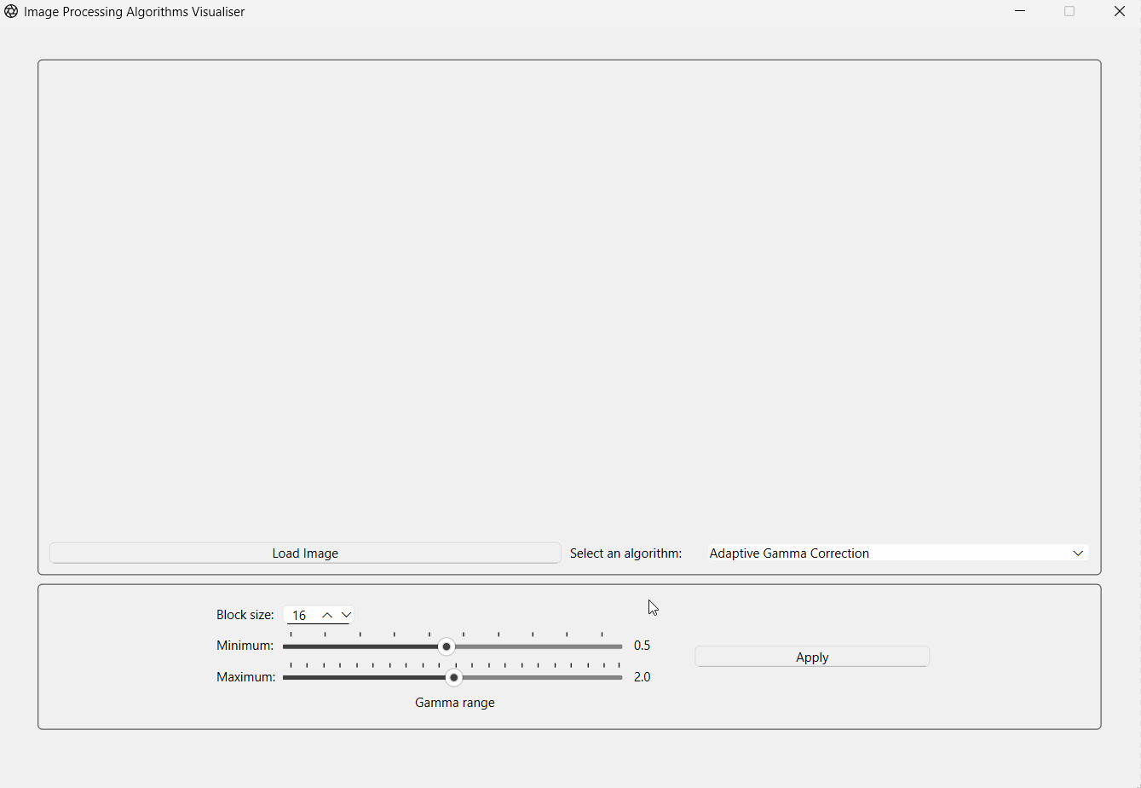
Histogram Equalization GUI demonstration:

Slide 39
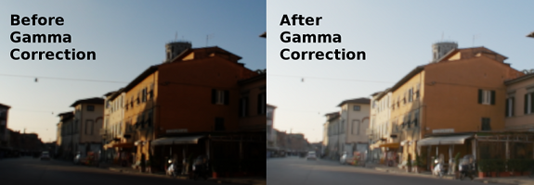
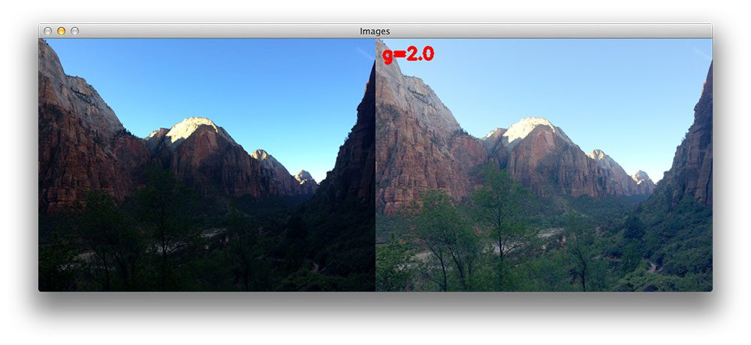
Gamma Correction

Slide 40
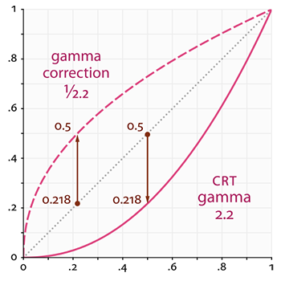
What is Gamma Correction?
Gamma correction adjusts the brightness of an image to ensure colours appear correctly on screens, accounting for the non-linear display characteristics of devices.
It maps input values through a correction function tailored to the display device's characteristics, ensuring the encoded and decoded luminance in digital images and videos is accurate.
This process is crucial for displaying images as they were captured, preventing colours from appearing washed out or overly bright.

Slide 41
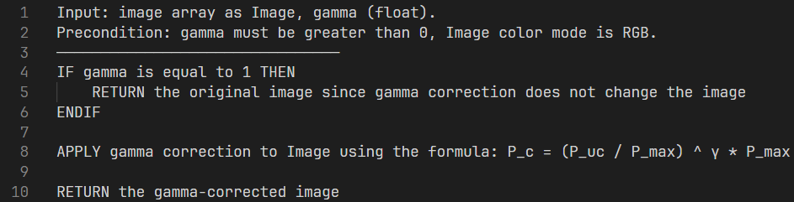
Gamma Correction pseudocode:

Slide 42
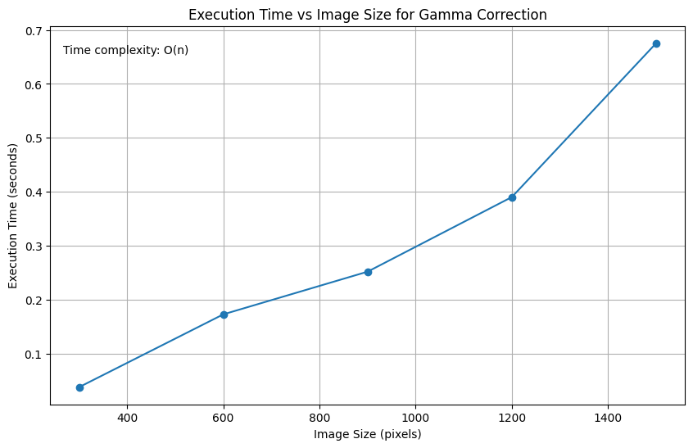
Gamma Correction empirical analysis

Slide 43
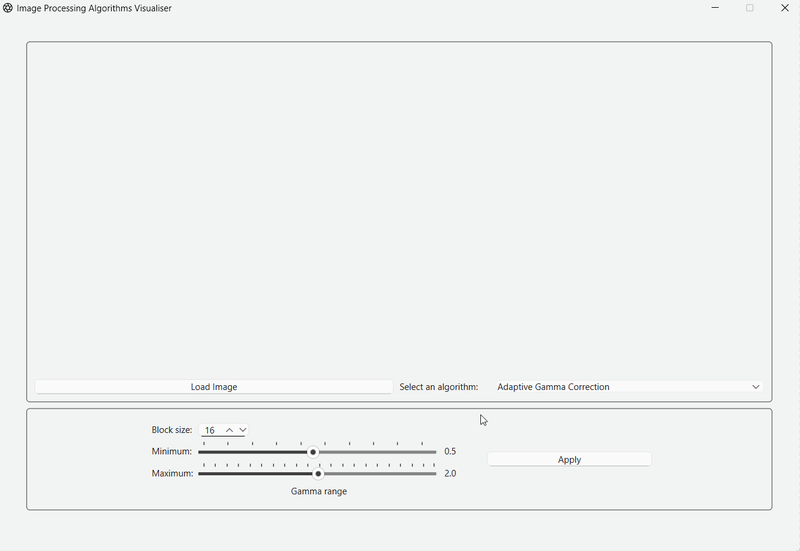
Gamma Correction GUI demonstration:

Slide 44
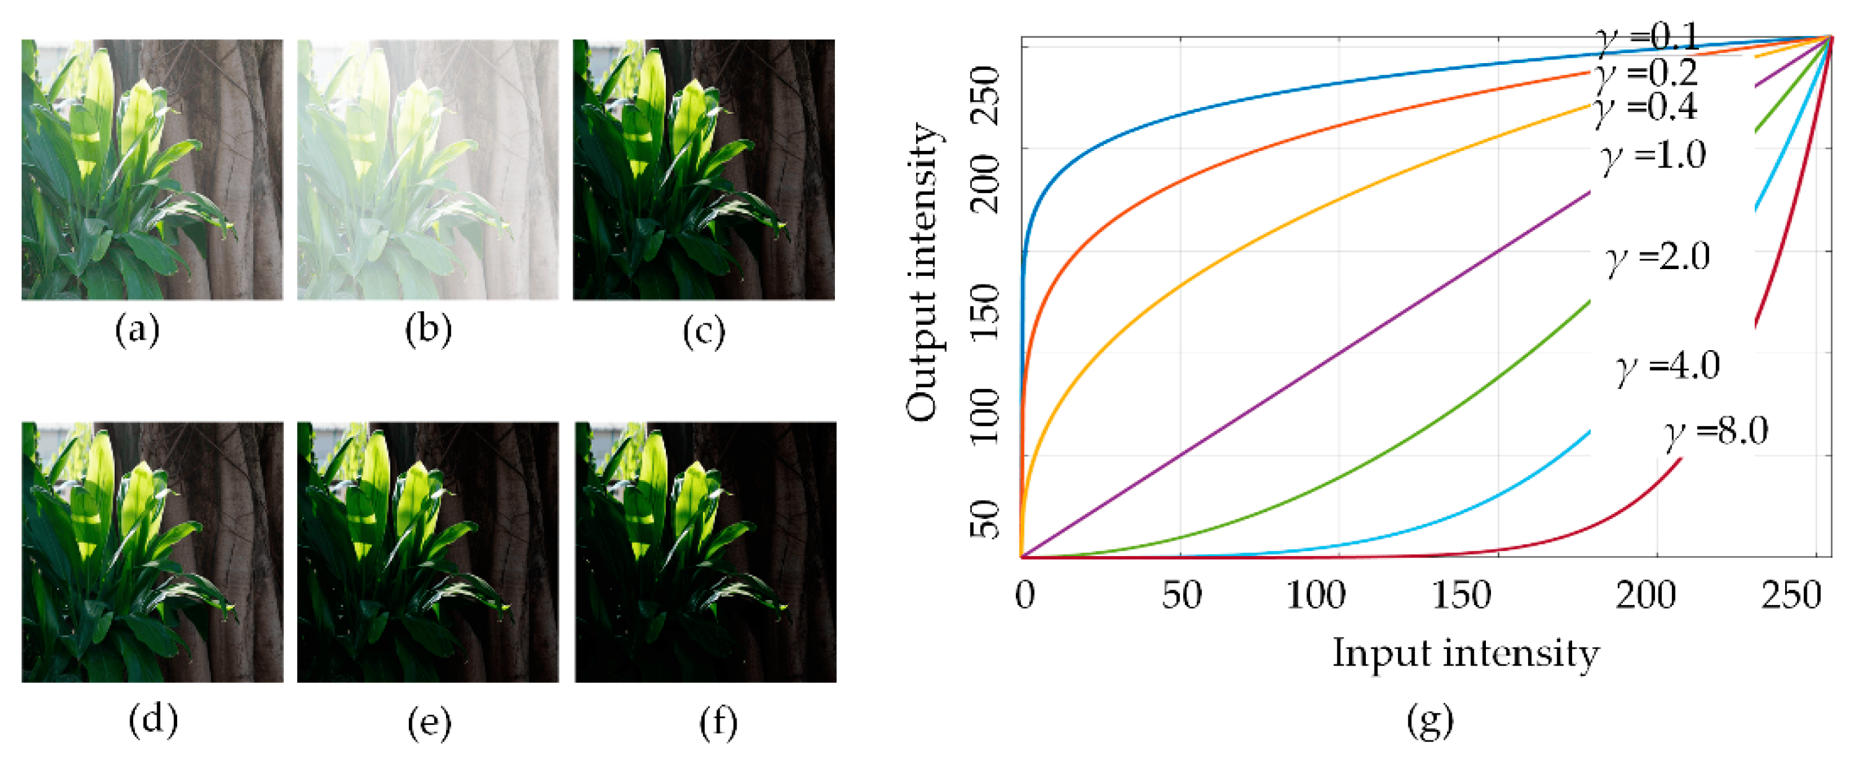
Adaptive Gamma Correction

Slide 45
What is Adaptive Gamma Correction?
Adaptive Gamma Correction (AGC) enhances image contrast by dynamically adjusting the gamma correction parameters based on the image's characteristics.
Unlike static gamma correction, which uses fixed parameters, AGC tailors the gamma correction to the specific needs of each image, optimizing both brightness, contrast, and colour.
This adaptability makes AGC particularly effective for images with varying lighting conditions or those requiring nuanced contrast adjustments.
There are multiple techniques for dynamically correcting the gamma. We used the blocks technique.

Slide 46
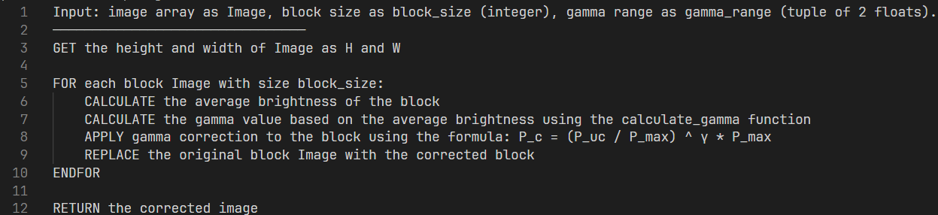
Adaptive Gamma Correction pseudocode:

Slide 47
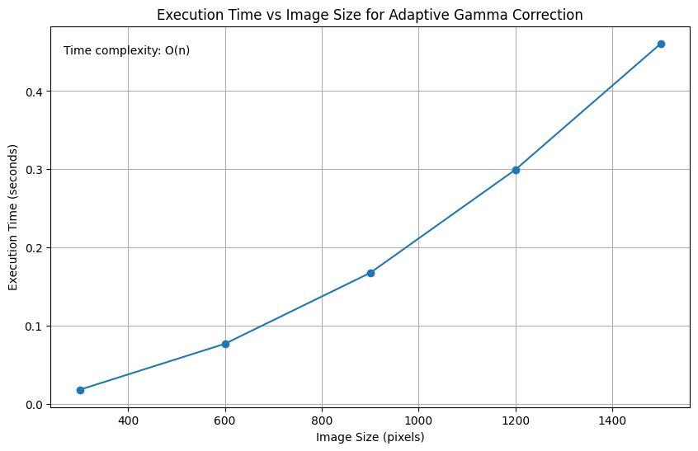
AGC empirical analysis

Slide 48
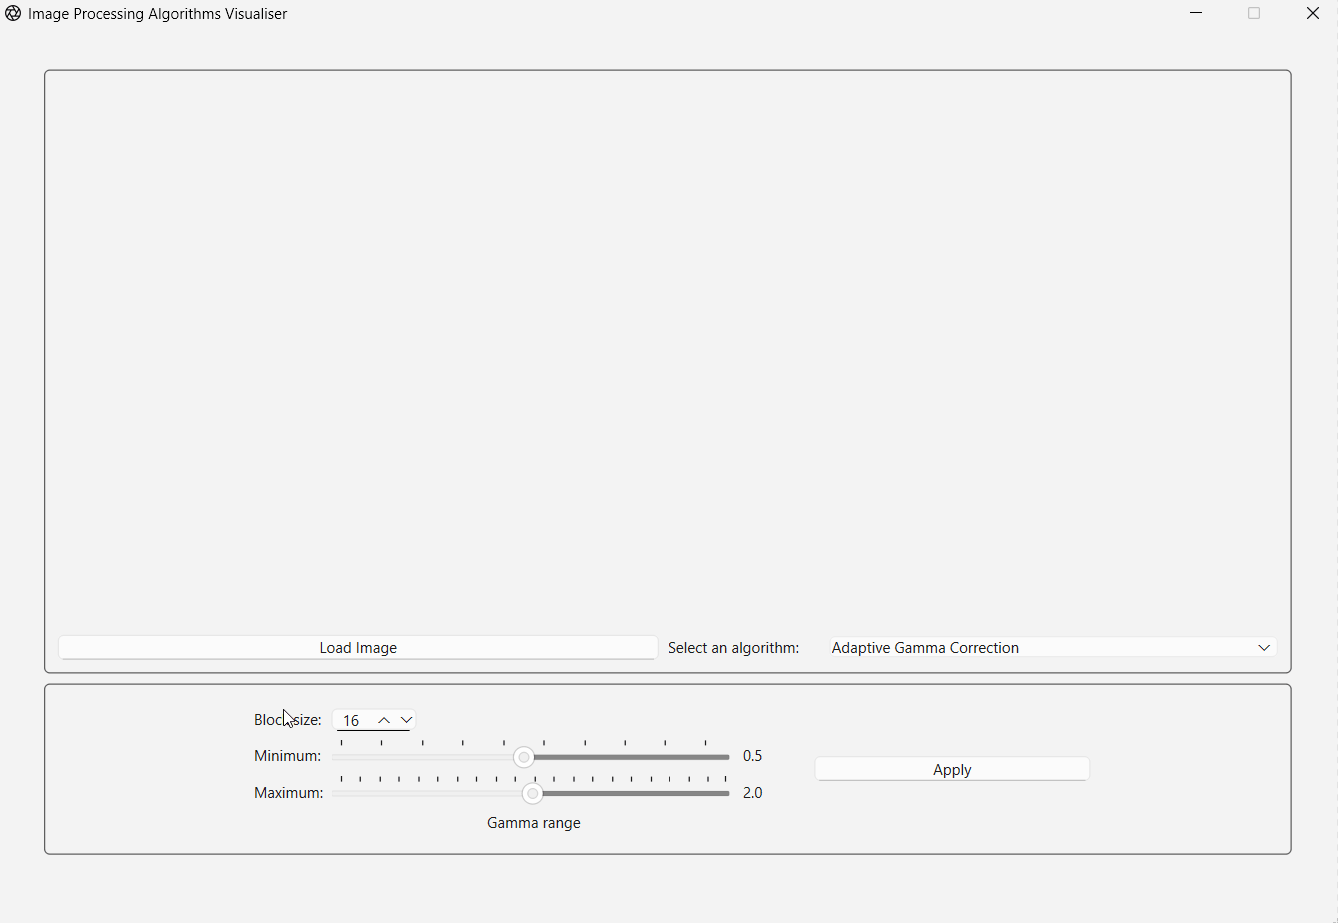
Adaptive Gamma Correction GUI demonstration:

Slide 49
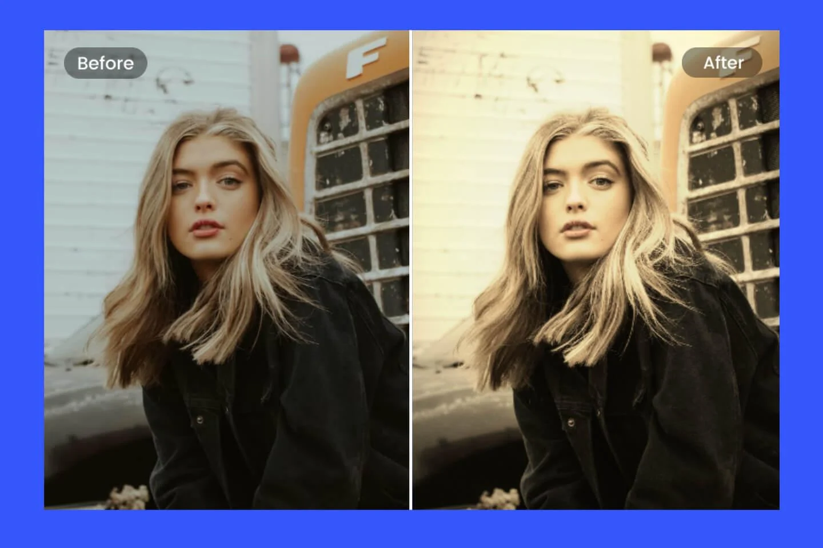
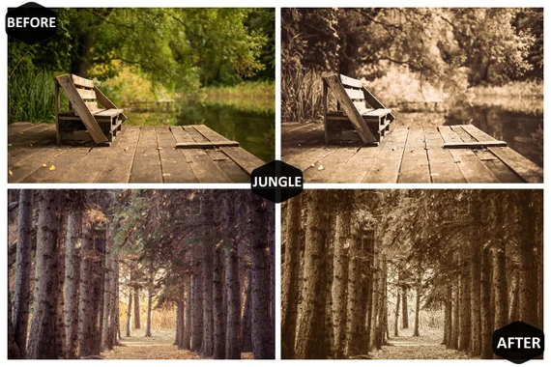



Sepia Filter (Bonus algorithm ☺)

Slide 50

Sepia filter pseudocode:

Slide 51

Sepia Filter empirical analysis

Slide 52

Sepia GUI demonstration:

Slide 53

Thank you for listening!

